Slide 1
Predicting High Traffic Recipes
Tasty Bites
German Paul
24.11.23
Notes:
Hello to my presentation about analysing high traffic recipes

Slide 2

German Paul
Head of Data Science
Tasty Bites

Slide 3
Problem Statement
Classify high traffic recipes
Reach an accuracy over 80%

Slide 4



Steps to reach the goal
Data Validation
Data Visualization
Model creation

Slide 5
Data Validation
Data Validation
2. Data Formatting
3. Data Transformation

Slide 6
Data Validation
Check for unique values in every column
df.column.nunique()
Check for distribution
df.column.value_counts()

Slide 7
Data Formatting
4 as a snack
4
Nutrient NaN
Mean values

Slide 8
Data Transformation
x_data
Standardized x_data
Categorical Category column
Label encoded category column

Slide 9
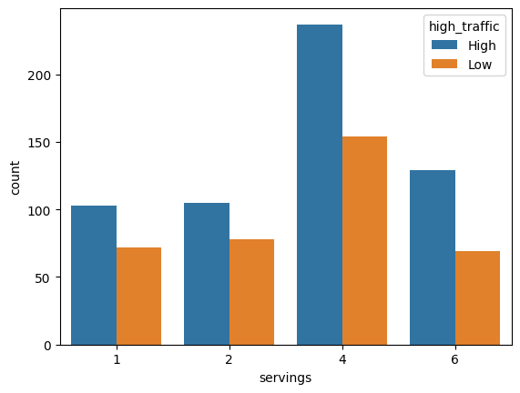
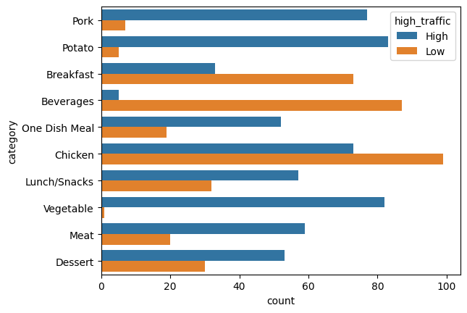
Data Visualization

Slide 10
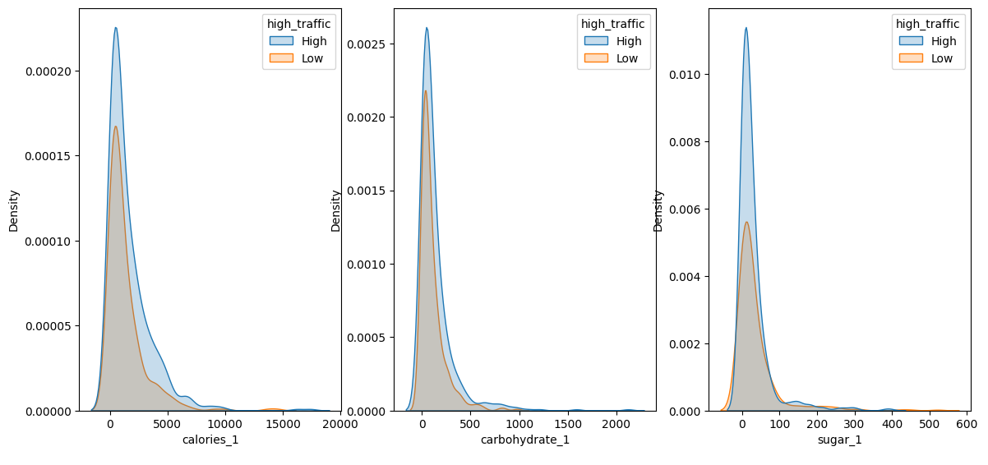
Data Visualization

Slide 11
Model Creation
Logistic Regression
Linear SVC
Accuracy of 76%
Accuracy of 74%
Use of GridSearchCV to find best parameters

Slide 12
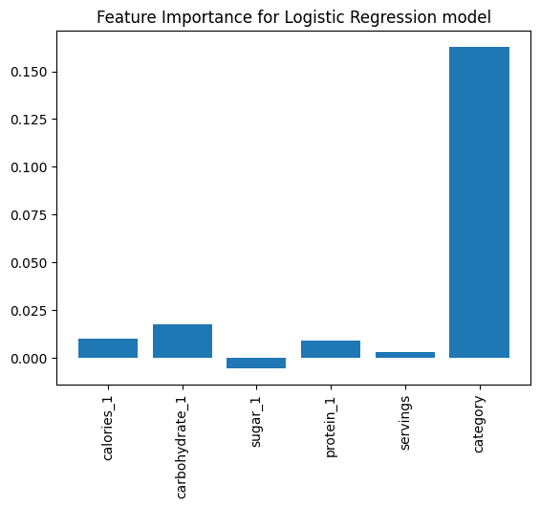
Logistic Regression

Slide 13
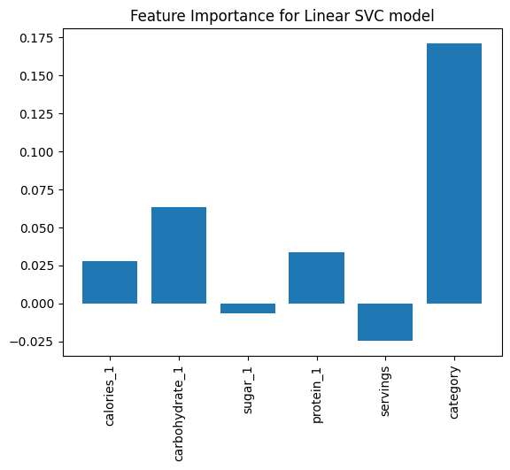
Linear SVM

Slide 14

Improving the Model
The model can only be as good as the data provided
Getting more data

Slide 15
MODEL ANALYSIS
High Accuracy
Logistic Regression
Linear SVM
Hard to understand
Easy to understand
Always choosing High Traffic
Naive Bayes
XGBoost Classifier
Low Accuracy

Slide 16




Solution
Tasty Bites should implement the Logistic Regression Model in production
Make customers happy
Open-Source
Efficient algorithm - easy to retrain

Slide 17

RISK
CHALLENGES
Cybersecurity breaches and data leaks.
Attracting and retaining top cybersecurity talent.
Economic downturns impacting IT budgets.
Scaling operations to meet growing demand.
Emerging competitors disrupting the market.
Adapting to evolving technology and threat landscape.

